Slide 1
Design and Simulation of a 4-bit Magnitude Comparator using Verilog HDL

Slide 2
What is a Magnitude Comparator ?
It is a Combinational Circuit.
It compares two binary numbers and tells us which one is Greater, Smaller, or equal (>, <, =).
for, example
a=01,b=00
a>b output= 1(True)

Slide 3
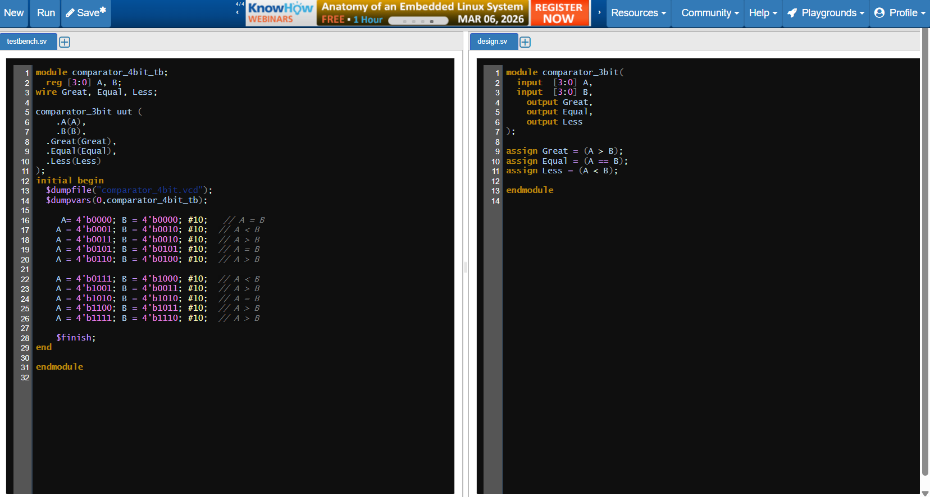
Design and Simulation

Slide 4
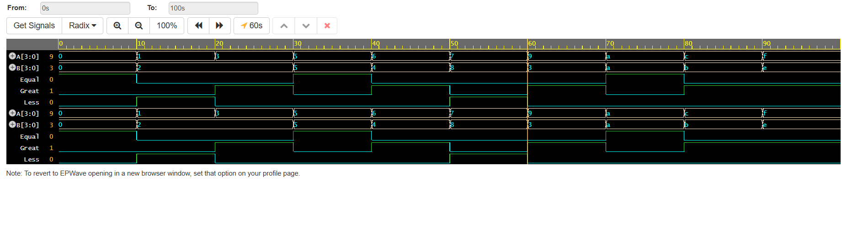
Output Waveform

